Slide 1
1) Introduction To ERP:
-- An overview
-- Enterprise: An overview
-- Benefits of ERP

Slide 2
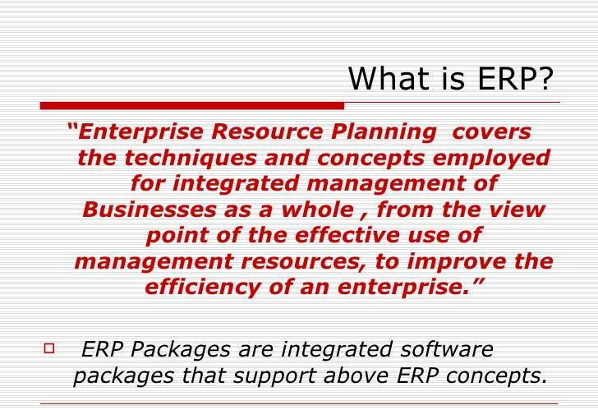

Slide 3
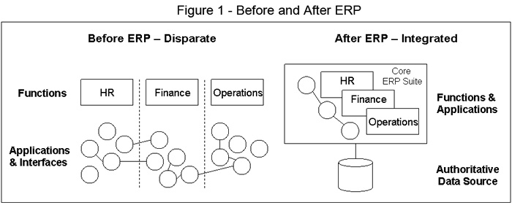

Slide 4
THE ADVANTAGES OF ERP
Business integration
Flexibility
Better analysis and Planning Capabilities
Use of Latest Technology

Slide 5
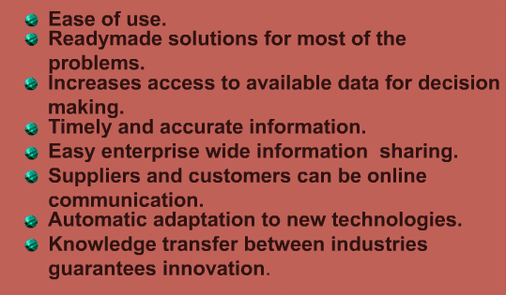
THE ADVANTAGES OF ERP cont…..

Slide 6
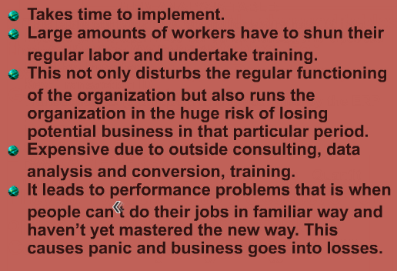
The Disadvantages Of ERP

Slide 7
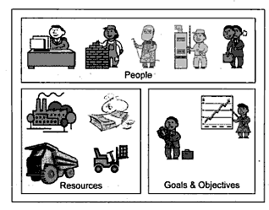
Enterprise: An overview

Slide 8
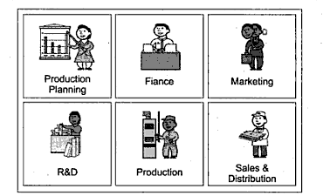

Slide 9
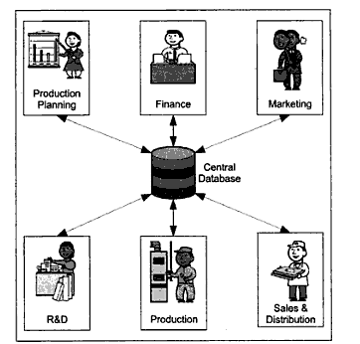
Integrated Management Information

Slide 10
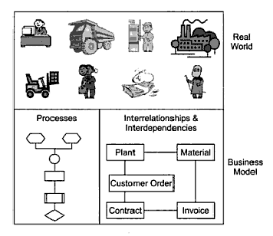
Business modeling

Slide 11
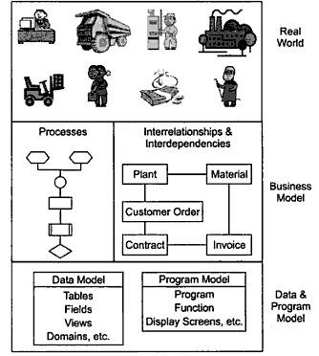
Integrated Data model

Slide 12
Benefits Of ERP
Reduction of lead time
On time shipment
Reduction in cycle time
Better customer satisfaction
Improved supplier performance
Increased flexibility
Reduction in quality costs
Improved resource utility
Improved information accuracy and decision making capability

Slide 13
ERP
General Concepts
http://www.open-source-erp-site.com

Slide 14
ERP – General Concepts
What is ERP?
The Current Scenario
Why ERP?
Definition
Evolution
Expectations
BPR & ERP
BPR – The Steps
Enterprise Resource Planning
http://www.open-source-erp-site.com

Slide 15
Assignment
What is Enterprise?
What are Integrated modules ?Why ERP is considered as a system of integrated modules?
Explain real world and business module ? How they are co related?
Explain advantage and disadvantages of ERP.

Slide 16
ERP is a solution, which
facilitates company-wide integrated
information systems, covering all
functional areas
performs core Corporate activities and
increases customer service augmenting
Corporate Image
Enterprise Resource Planning
http://www.open-source-erp-site.com

Slide 17
The Current Scenario
Islands of Information
Difficult to get timely & accurate information
Heterogeneous Hardware & Software
platforms & practices
Poor connectivity between different
organizational locations
Sticking with obsolete technology
Resist to change
Lack of proven man-power to develop
integrated software
Enterprise Resource Planning
http://www.open-source-erp-site.com

Slide 18
Why ERP?
For Management – to know what is happening
in the company
One solution for better Management
For cycle time reduction
To achieve cost control & low working capital
To marry latest technologies
To Balance the geographical gaps
To satisfy the customers with high expectations
To be Competitive & for survival
Enterprise Resource Planning
http://www.open-source-erp-site.com

Slide 19
ERP - Definition
“Software solution that addresses the
Enterprise needs, taking a process view of
the overall organization to meet the goals,
by tightly integrating all functions and
under a common software platform”
Enterprise Resource Planning
http://www.open-source-erp-site.com

Slide 20
Evolution of ERP
1960’s - Systems Just for Inventory Control
1970’s - MRP – Material Requirement Planning
(Inventory with material planning & procurement)
1980’s - MRP II – Manufacturing Resources Planning
(Extended MRP to shop floor & distribution Mgnt.)
Mid 1990’s - ERP – Enterprise Resource Planning
(Covering all the activities of an Enterprise)
2000 onwards – ERP II – Collaborative Commerce
(Extending ERP to external business entities)
Enterprise Resource Planning
http://www.open-source-erp-site.com

Slide 21
ERP – Expectations
Integrating all the functions
Integrating the systems running in all the locations
Transparency of information using a single
data source across the organization
Software must be responsive
    Modular
    Flexible
    Easy to add functionalities
    Provide growth path
Enterprise Resource Planning
http://www.open-source-erp-site.com

Slide 22
BPR & ERP
Just automating the existing business practices
will not help ERP to achieve the anticipated results
Business Process Re-engineering [BPR] brings out the
deficiencies of the existing setup
BPR and ERP will give way to implement new
systems and the long pending improvements in the
existing systems
BPR may be time consuming but the scope can be
restricted & controlled by the Management
Business Process Re-engineering
http://www.open-source-erp-site.com

Slide 23
BPR - Steps
Step 1 | Step 2 | Step 3
Understand | Simplify/Improve | Automate
Understand the existing systems associated with all the functionalities | Draft & frame the possibilities & ways to simplify or Improve or eliminate the processes | Implement with the help of ERP
Business Process Re-engineering
http://www.open-source-erp-site.com

Slide 24
ERP – Options
OPTION 1 – MAKE [Using Internal resources]
Developing a custom-built ERP package, specific to the
requirements of the organization, with the help of the
in-house IT department
OPTION 2 - BUY
Going for Tailor-made ERP packages available in the market like
SAP, Oracle applications, Baan, PeopleSoft etc.
OPTION 3 – MAKE [using External resources]
Developing a custom-built ERP package, specific to the
requirements of the organization, with the help of a
software solution provider
Enterprise Resource Planning
http://www.open-source-erp-site.com

Slide 25
Building ERP solutions
using
Internal Sources
http://www.open-source-erp-site.com

Slide 26
ERP – Building using Internal
resources – The Facts
Lack of adequate & qualified manpower
Not driven with clear focus on expectations,
time & cost
Poor software project management
Lack of seriousness with the Management & the
IT Team
High employee turnover
Lot of schedule gaps during Project execution
Normally project life is more
Frequent change in the scope with the approval
of the Management
http://www.open-source-erp-site.com

Slide 27
Assignment
Explain “ERP is the extension of inventory control or MRP”
Challenges to implement ERP.

Slide 28
Tailor-made
ERP
Solutions
http://www.open-source-erp-site.com

Slide 29
Tailor-made ERP solutions
Customized
ERP product selection phase
Product selection - Parameters
Preparation Phase
ERP product acceptance - Options
Gap Analysis
Production Phase
Implementation Phase
Post-Implementation Phase
Pitfalls & Points of Concern
Critical Success factors
Tailor-made ERP solutions
http://www.open-source-erp-site.com

Slide 30
About
Generalized off the shelf application s/w packages
Modules based on rich functionalities for all business
functions
User tested with lot of installations
No lead time requirement for software development
Tuned for more users/networks with adequate & in-
built security
Parameterized for flexibility
Can sit on latest hardware & software platforms
Upgradation of functionalities with version control
Tailor-made ERP solutions
http://www.open-source-erp-site.com

Slide 31
Execution phases
ERP product selection
Preparations
Production
Implementation
Post-Implementation
Tailor-made ERP solutions
http://www.open-source-erp-site.com

Slide 32
ERP Product selection Phase
ERP Team formation for selection
Appointment of Consultants [if needed]
Scoping study
Product selection
Implementation partners selection
Hardware/Communication cost estimation
Tailor-made ERP solutions
http://www.open-source-erp-site.com

Slide 33
Product Selection - Parameters
Reputation of the ERP product
No.of installations in the geographical vicinity
% of the overall functional availability
Customization possibilities
After sales support
Your investment plan & budget
Implementation partner’s track record
Tailor-made ERP solutions
http://www.open-source-erp-site.com

Slide 34
ERP Product selection Criteria
Goal:
To select the
Most Suitable Software
Package Solution
Functionality
5 Strategic
Requirement
Levels
Technology
Vendor
Support
Costs
http://www.open-source-erp-site.com

Slide 35
Preparation Phase
Framing ERP Implementation Strategies
Formation of Apex & Steering committees
Functional & IT team formation
Training on ERP functions & features
Scope finalization
GAP analysis
Action plan to resolve the gaps
Tailor-made ERP solutions
http://www.open-source-erp-site.com

Slide 36
ERP product acceptance - options
Adapting directly, all the functions available in
the ERP Product [Applicable for startup companies]
2. Change the way the firm does the business to fit
the product [Compromising]
3. Customize the ERP product to suit the business
Processes. [Customization]
Tailor-made ERP solutions
http://www.open-source-erp-site.com

Slide 37
GAP Analysis
This is the process to identity the gaps by mapping
the expectations of the company with the
capabilities of the ERP product
Results of Gap Analysis
Directly Supported
Workaround suggested
Extension required
Change in business process – suggested
Not full supported
Manual – not under the scope of ERP
Tailor-made ERP solutions
http://www.open-source-erp-site.com

Slide 38
Production Phase
Installing the software & hardware
Tuning the software to meet the
customization needs
Master & Control data arrival as per
the Product data structures
Location & people specific roles & rights
allocation for module access & security
Tailor-made ERP solutions
http://www.open-source-erp-site.com

Slide 39
Implementation Phase
Conference Room Pilot [Parallel run]
Resolving the Parallel run issues
Training the end users
Live run
Tailor-made ERP solutions
http://www.open-source-erp-site.com

Slide 40
Post-Implementation Phase
Regular monitoring
Tuning [hardware/software] for patching
the performance issues
Maintenance
Tailor-made ERP solutions
http://www.open-source-erp-site.com

Slide 41
Pitfalls & Points of concern
Costly comparing to custom-built options
Lot of hidden costs
Chances of cost & time overrun are high
The Level of customization/Indianization
Compulsion to pay for redundant modules/features
Vigorous involvement of all during implementation
Non-availability of special practices like Customer
Complaint, Logistics
Linking historical data – offline & painful
The requirement of Change Management is a must
Dependency on outsiders is high
IT department – Poor grip on the Implemented systems
Tailor-made ERP solutions
http://www.open-source-erp-site.com

Slide 42

Critical Success Factors
The firm & optimistic approach of the Management
  on adapting the ERP product driven methodologies
  on customization
  on monetary commitments
The dedicated Team
Good Training
Strict adherence to the Project schedules
Right technical infra-structure
Change Management
Tailor-made ERP solutions
http://www.open-source-erp-site.com

Slide 43
Custom-built
ERP
Solutions
using external resources
http://www.open-source-erp-site.com

Slide 44
Building ERP using Ext.sources
About this option
The Principle!
The Steps
Why?
Points of Concern
Software Vendor selection
Critical Success factors
http://www.open-source-erp-site.com

Slide 45
About
Here the whole package is designed & built
by keeping a specific enterprise & its business
Practices in mind
by incorporating the improvements/additions
with due integration
without compromising or changing the current way
of doing the business and
providing flexibility to accommodate your business
fluctuations
Custom-Built ERP solutions
http://www.open-source-erp-site.com

Slide 46
The Principle!
The best as seen elsewhere, need not be the
the best for you.
What is your best is what
can be successfully implemented
Custom-Built ERP solutions
http://www.open-source-erp-site.com

Slide 47
The Steps
Software vendor selection
Detailed study by the vendor
Scope & platform finalization
Freezing the commercials
Development
Hardware addition/upgradation
Old master/transaction data migration
Parallel run with Integration & connectivity check
Implementation
Maintenance
Custom-Built ERP solutions
http://www.open-source-erp-site.com

Slide 48
Why?
Very economical while comparing the cost of implementing
tailor-made ERP solutions
Less prone for hidden-cost hits
The company can opt for its choice of Hardware, Software &
communication platforms based on the skill availability
The company and the software vendor have the direct
relationship during the project execution. The proximity
would be high & convenient.
IT department has good control over the Project
What is required only would be considered under the scope –
No redundancy
Custom-Built ERP solutions
http://www.open-source-erp-site.com

Slide 49
Points of Concern
Software development vendor selection
Requirement/scope finalization [high chances of
retaining the islands as it is]
Less chances of Value addition
Not time tested
Chances of Prolonged project duration
http://www.open-source-erp-site.com

Slide 50
Software Vendor Selection
The following traits should be considered while selecting the software vendor for building the ERP application
  Technical expertise
  Domain knowledge
  Adequate manpower
  Project management skills
  Long existence in the field
http://www.open-source-erp-site.com

Slide 51
The Critical Success Factors
Clear Vision & support of the Management
Capabilities of the software development vendor
Scope & Expectations finalization towards
meeting the ERP concepts
Strict implementation schedules & periodical
monitoring
The involvement of the IT & functional teams
Custom-Built ERP solutions
http://www.open-source-erp-site.com

Slide 52
REASONS FOR THE GROWTH OF THE ERP MARKET
To enable improved business performance
  Cycle time reduction work fast by ERP
  Increased business agility
  Inventory reduction
  Order fulfillment improvement day by day by using erp
To Support business growth requirements
  New products/product lines, new customers updated pakages.
  Global requirements including multiple languages and currencies for different countries.
To provide flexible, integrated, real-time decision support
  Improve responsiveness across the organization every person takes works as .
To eliminate limitation in legacy systems
  Century dating issues
  Fragmentation of date and processing
  Inflexibility to change
  Insupportable technologies
To take advantage of the untapped mid-market (medium size organizations)
  Increased functionality at a reasonable cost
  Client server/open system technology
  Vertical{Being or situated at right angles to the horizon; upright.} market solutions

Slide 53
Assignment
Identification of exact module to implement ERP comes under which phase? How the phase is carried out?
Explain the process which identifies the difference between industry expectation and actual ERP implementation.

